Slide 1
7 Segment Display
CSE 315
Peripherals & Interfacing
Abdullah Al Omar
Lecturer, CSE, UAP

Slide 2
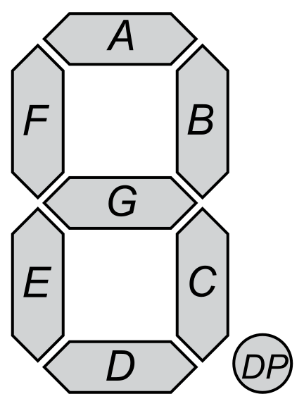
Agenda
Today We'll learn about 7 segment display and it's arduino usage

Slide 3
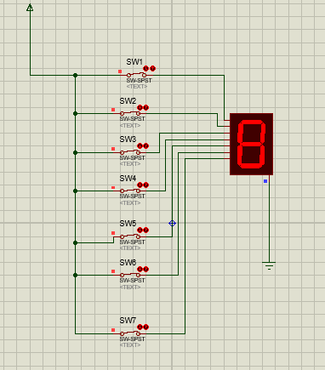
What is 7 segment display?
An LED or Light Emitting Diode, is a solid state optical pn-junction diode which emits light energy in the form of photon. The main advantage of light emitting diodes is that because of their small die size, several of them can be connected together within one small and compact package producing what is generally called a 7-segment Display.

Slide 4
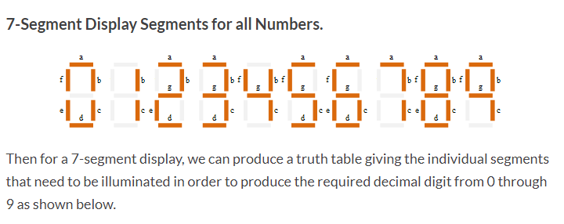

Why 7 Segment?

Slide 5
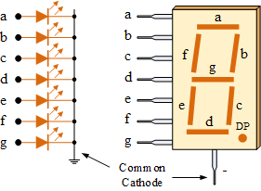
Types of 7 Segment display
The Common Cathode (CC) – In the common cathode display, all the cathode connections of the LED segments are joined together to logic “0” or ground. The individual segments are illuminated by application of a “HIGH”, or logic “1” signal via a current limiting resistor to forward bias the individual Anode terminals (a-g).

Slide 6
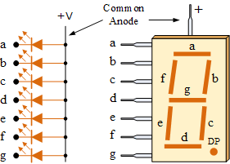
Types of 7 segment display (contd.)
The Common Anode (CA) – In the common anode display, all the anode connections of the LED segments are joined together to logic “1”. The individual segments are illuminated by applying a ground, logic “0” or “LOW” signal via a suitable current limiting resistor to the Cathode of the particular segment (a-g).

Slide 7
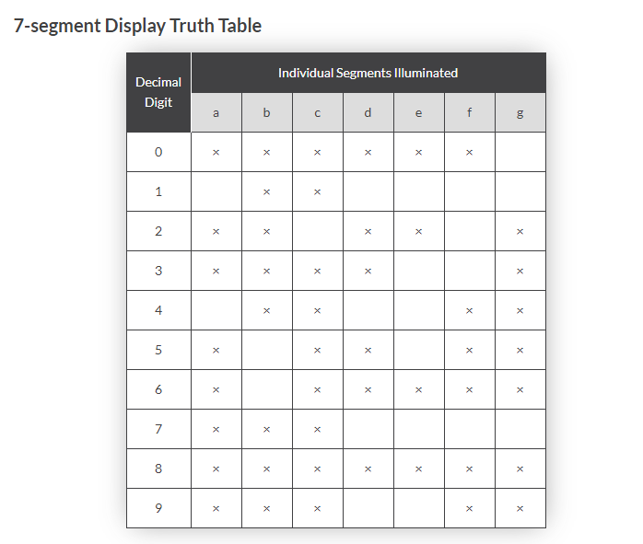
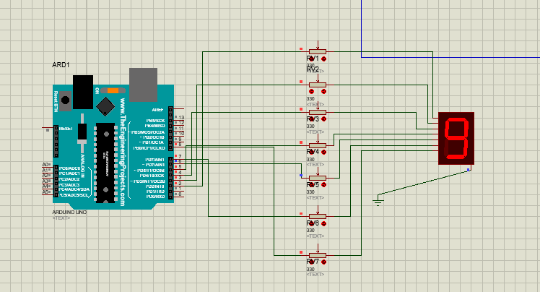
Truth Table of 7 segment
Here "x" means switch is closed/connected so that current can pass through that pin

Slide 8
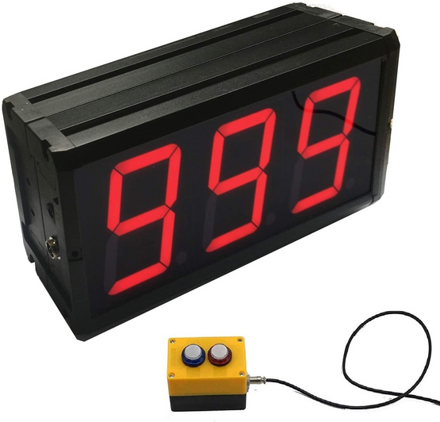
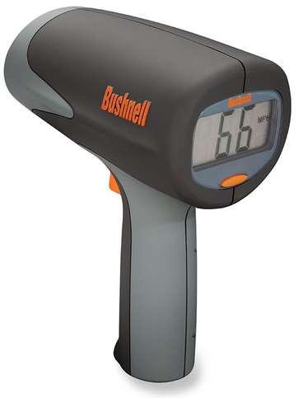
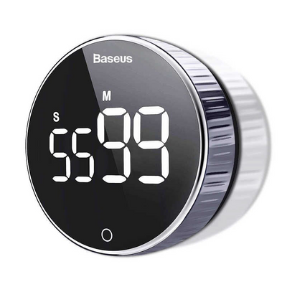

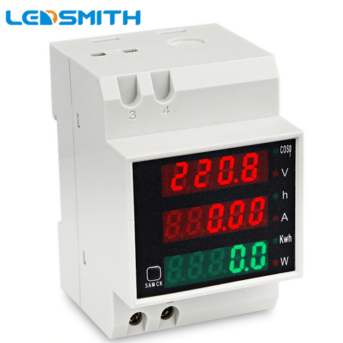

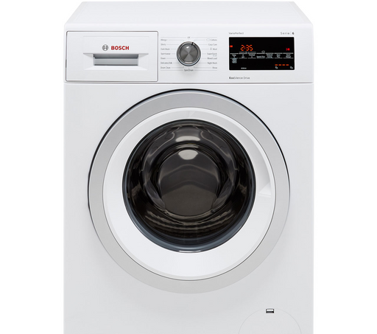
Some Use Case
Counter
Speed measuring device
Digital Clock
Cashier machine
Digital meter
Microwave oven
Washing machine

Slide 9
Lets see codes & Simulation output

Slide 10



Slide 11




Slide 12


Slide 13
Equipments:
Arduino Uno
7SEG-COM-CATHODE
Resistor 330 Ohm (X7)
Ground

Slide 14
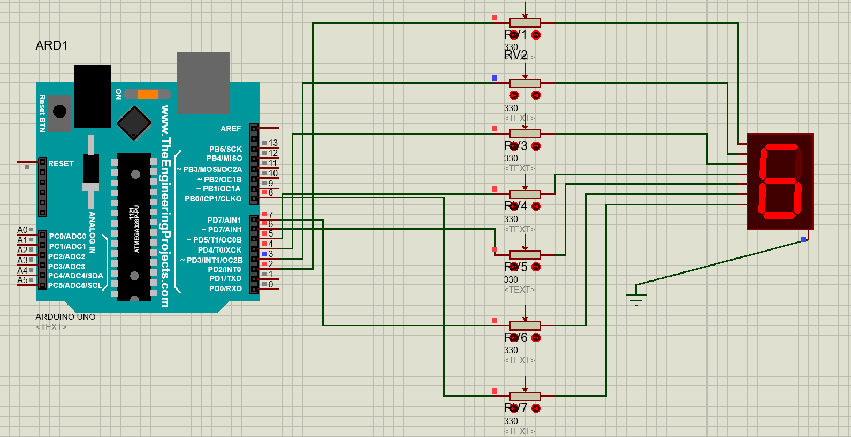
Arduino Design:

Slide 15
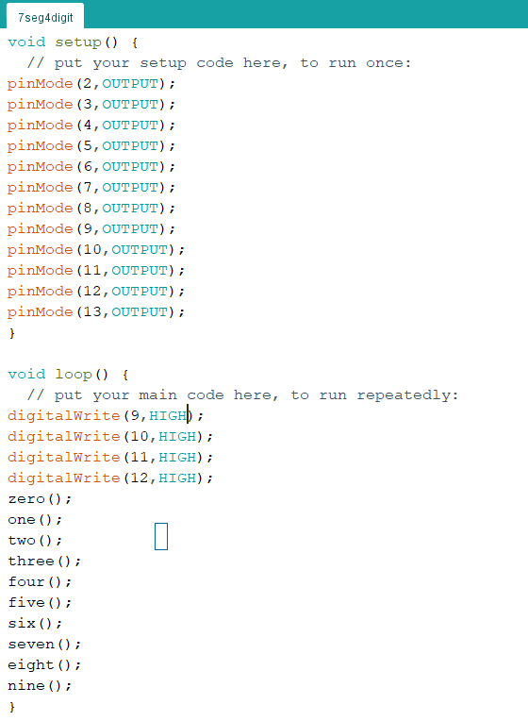




4 digit 7 segment:

Slide 16
Equipments:
Arduino Uno
7SEG-MPX4-CA-BLUE
Resistor (X7)
NOT(X7)

Slide 17
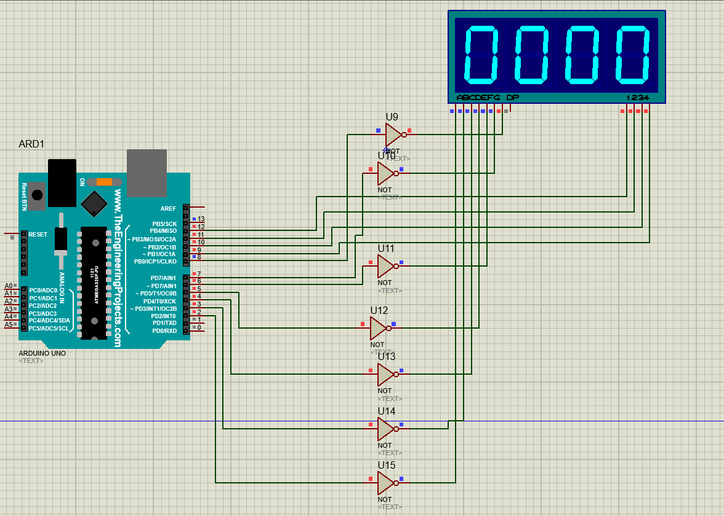
4 digit 7 segment:

Slide 18
Thank you!
Thank you!

